Slide 1

Analysis of S&P Global Market Intelligence Glassdoor Reviews
HR Insight & Analytics
CRISIL Corporate Data Analytics
February 2016
Notes:
Abhishek

Slide 2

Agenda
Executive Summary
Methodology
Overview
Key Attributes
Internal and External Benchmark
Appendix

Slide 3
Executive Summary
Objectives
Gauge how CAPIQ and SNL are perceived by employees of different status, locations and positions
Identify hidden issues that may impact employee engagement within the business
Establish key differentiators amongst peers
Key Observations
Employees began posting more reviews from 2012 and the current average rating is 3.3.
Major discussions from all locations and employee status are around work life balance, work environment and management.
Work life balance, work environment, training & learning drive people’s decision to have positive reviews while attributes such as career growth, compensation, cost cutting affect people’s optimistic outlook
Most reviews come from New York and Andhra Pradesh and employees in Delhi and Andhra Pradesh carry highest percent of positive reviews.
The overall rating is slightly higher than other divisions in MHFI but lower than other competitors in the industry.
* The rating is on a scale of 5 and the time frame of the analysis is from 2009 to 2015

Slide 4
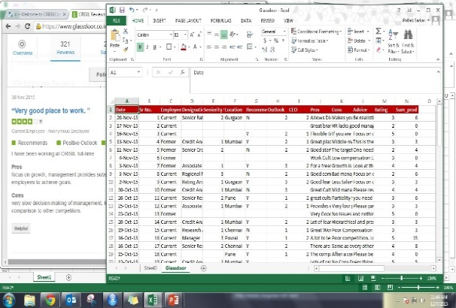
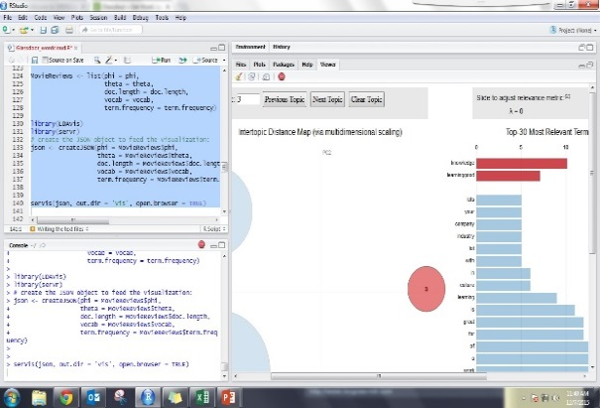
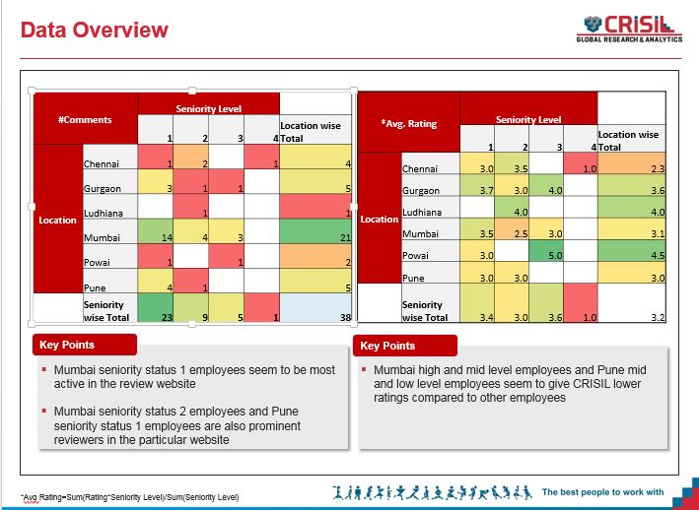
Methodology
Data Collection
Data Analysis
Insights
Extracted Employee review data from Glassdoor
Collected the review data across different dimensions and behavioural attributes
Calculated Weighted Average rating based on designations
Summarized the data across different dimensions
Prepared wordcloud and performed sentiment analysis on the employee review
Used R for Performed
Frequency analysis
Built wordclouds across different dimensions
Compared positive and negative dominant themes to identify possible employee engagement roadblocks
Conducted a hiring trend analysis.

Slide 5






Overview -1
437
66
~7
3.35
CEO Approval
Current Avg. Rating of the Business*
# Reviews
# Months
# Monthly Average Reviews
49%
27%
2.23
Avg. Recommender Score
Avg. CEO Approval
Positive : Negative
* The rating is on a scale of 5 and the time frame of the analysis is from 2009 to 2015

Slide 6
Overview -2
437
Location
Location | #Reviews | Avg. Rating
New York | 94 | 3.1
Andhra Pradesh | 76 | 3.6
Haryana | 68 | 3.4
England | 19 | 3.1
Delhi | 7 | 3.7
Hong Kong | 6 | 4
Federal Capital | 4 | 3.1
Illinois | 4 | 3.8
Manila | 4 | 3.3
Colorado | 3 | 1.9
New Jersey | 3 | 3
Massachusetts | 2 | 3
Arkansas | 1 | 2
Dubai | 1 | 5
Ile-de-France | 1 | 1
Maharashtra | 1 | 1
Ontario | 1 | 5
Uttar Pradesh | 1 | 1
Undisclosed | 141 | -
# Reviews
Position
Employee Status
Position | #Reviews | Avg. Rating
Analyst | 202 | 3.3
Sr. Analyst | 43 | 3.4
Manager | 182 | 3.3
Leadership | 10 | 2.8
Status | #Reviews | Avg. Rating
Former | 161 | 3.1
Current | 276 | 3.4
* The rating is on a scale of 5 and the time frame of the analysis is from 2009 to 2015
Notes:
Pallab

Slide 7
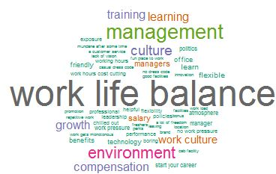
Overall Themes – Key Attributes
Top Discussion Topics
Overall Wordcloud
Key Points
Apart from work life balance, work environment is a highly discussed topic followed by management, training & learning and work culture
Notes:
Apart from work life balance, work environment is a highly discussed topic followed by management, training & learning and work culture

Slide 8
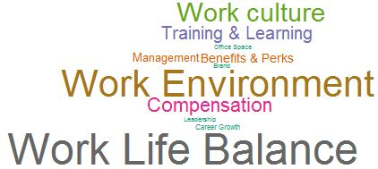
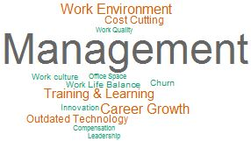
Pros vs. Cons – Key Attributes Word Cloud
Outlook – Positive Wordcloud
Outlook – Negative Wordcloud
Key Points
Factors such as work life balance, work environment, training & learning drive people’s decision to have positive outlook while attributes such as career growth, compensation, cost cutting affect people’s optimistic outlook

Slide 9

Pros vs. Cons – Key Attributes Frequency
Pros
Cons
Key Points
People enjoy the work environment, work life balance and appreciate the compensation provided to them
People carry mixed opinions around training & learning and career growth

Slide 10
Approval of the CEO from Mar 2009 to Sep 2015
CEO Approval Trend*
Acquisition of SNL Financial
Appointment of new president
*2009 and 2010 were excluded due to low number of reviews

Slide 11
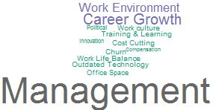
Recommender Score from Mar 2009 to Sep 2015
Recommender Score
Negative Wordcloud
Key Points
2011 and 2013 have lower recommender scores compared to other years
Non recommenders are unhappy about management, compensation, career growth and work environment
**2009 and 2010 were excluded due to low number of reviews
* NRS=%Recommendation - %Non-recommendation

Slide 12
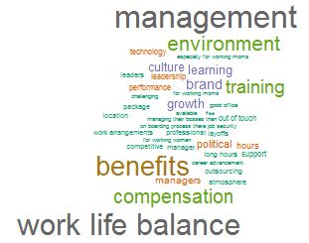
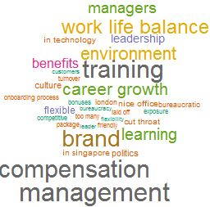
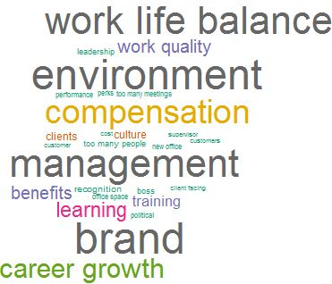
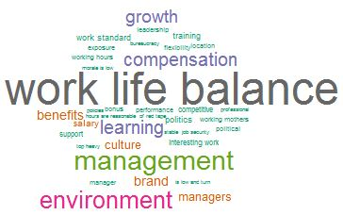

Internal Benchmark – Overall Ratings
Global Market Intelligence
MHFI
Platts
3.3
3.1
2.9
3.15
3.15
3.15
JDPA
S&P Dow Jones
S&P Ratings
2.9
3.2
3.8
3.15
3.15
3.15
* There were only 10 reviews for S&P Dow Jones and thus deep dive analysis was not conducted
* The rating is on a scale of 5 and the time frame of the analysis is from 2009 to 2015

Slide 13
Internal Benchmark – Key Sub-ratings
Career Opportunities
Comp & Benefits
Senior Leadership
Work Life Balance
Culture Values
* The rating is on a scale of 5 and the time frame of the analysis is from 2009 to 2015

Slide 14
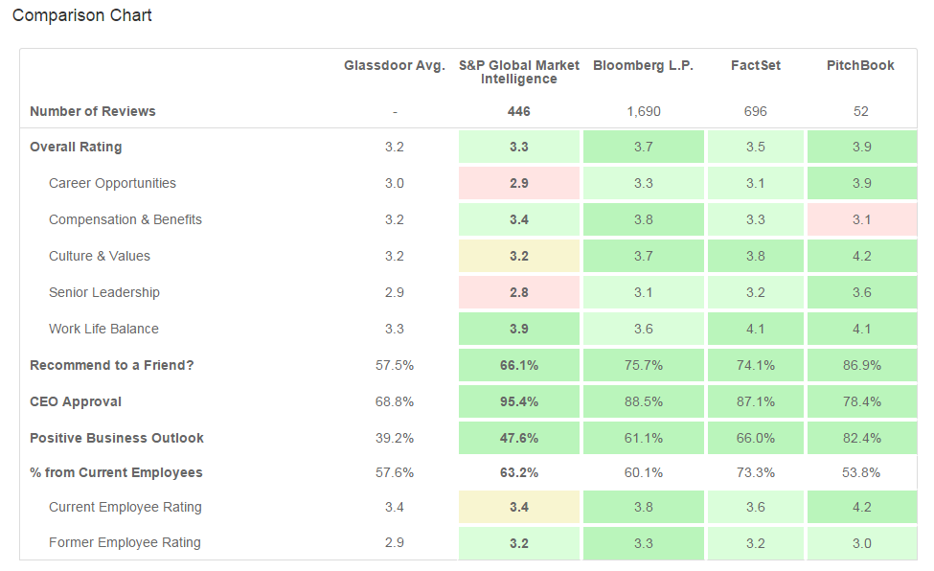
External Benchmark*
*The numbers in the External Benchmark slides were extracted directly from updated Glassdoor website and thus may vary with the numbers presented in the earlier slides

Slide 15
Appendix

Slide 16
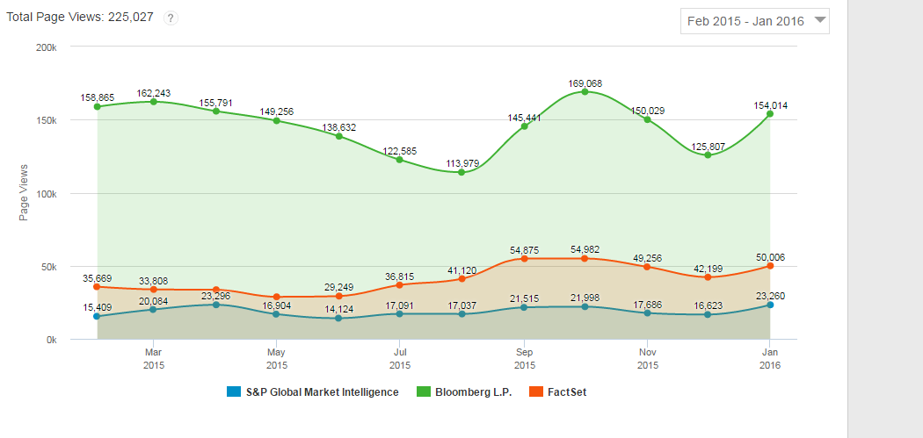
Total Page Reviews with competitors

Slide 17
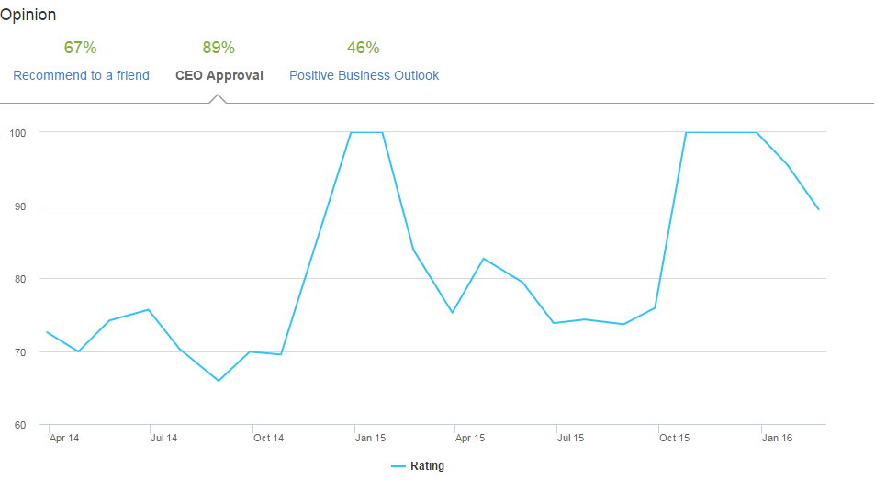
New CEO Approval Trend after Sep 2015

Slide 18
Rating and Outlook Across Locations
# Reviews and Avg. Rating
% Reviews with Positive Outlook
Key Points
People in Andhra Pradesh and England seems to carry a marginally higher positive outlook towards the business followed by people in Haryana and New York State

Slide 19

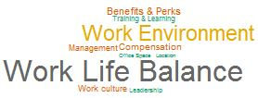



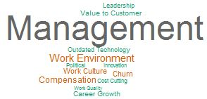
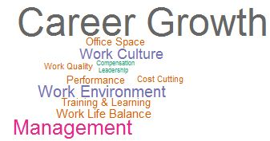

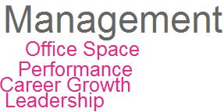

Pros and Cons across Different Locations
New York
Andhra Pradesh
Haryana
England
Pros
Cons
Top 4 locations were considered for this analysis

Slide 20
Rating and Outlook across positions
# Reviews and Avg. Rating
% Reviews with Positive Outlook
Key Points
Analysts and Managers have provided far more number of reviews than their peers with a higher rating. However, they seem to carry different attitude towards the business

Slide 21
Rating Distribution among the Key Attributes – 1
% Rating Distribution
Key Points
Work Life Balance and Compensation & Benefits seem to be the highest rated attributes
* 3 – Mid , <3 – Low , >3 – High

Slide 22
Rating Distribution among the Key Attributes – 2
Key Attribute Rating distribution across designation
Key Points
Analysts have highly rated the attributes such as Compensation & Benefits and Work Life Balance
Senior Analysts have rated Culture Values and Senior Leadership least among the other attributes
Leadership has rated all the attributes higher compared to Managers except for Compensation & Benefits and Culture Values

Slide 23
Rating and Outlook across Employee Status
# Reviews and Avg. Rating
% Reviews with Positive Outlook
Key Points
Current employees seem to have a more positive outlook towards the business and this is also getting reflected in their ratings to business

Slide 24

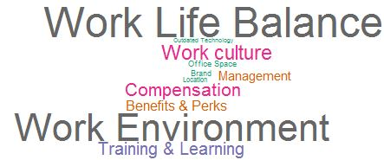
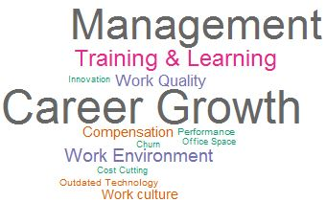
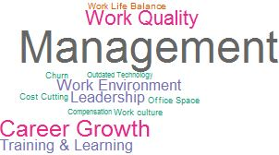
Pros and Cons across Different Status
Current
Former
Pros
Cons

